Slide 1
Machine Learning Project
Car Images Classification By Training Model
Team Members:
Dang Thu Ha Le
Mohan Lar
Truong Thanh Nam Nguyen
Huu Tam Nguyen

Slide 2

Deep Learning Steps
Data collection
Data Preparation
Training the Model
Serving Trained Model with API Server
Consuming the Model for Prediction
Notes:
Consider talking about:
Types of learning algorithms
Models
Training models

Slide 3
1. Data Collection
We use different methods to collect data
Notes:
Consider talking about:
Relation to data mining
Relation to optimization
Relation to statistics

Slide 4
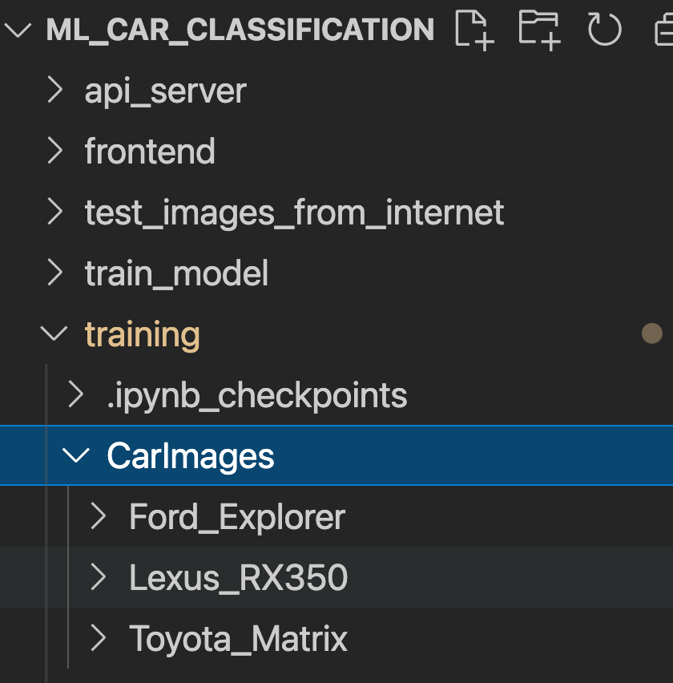
Data Collection from Internet
We download the Data from the Internet
Total Files = 193
Classified into 3 classes
Ford_Explorer
Lexus_RX350
Toyota_Matrix

Slide 5
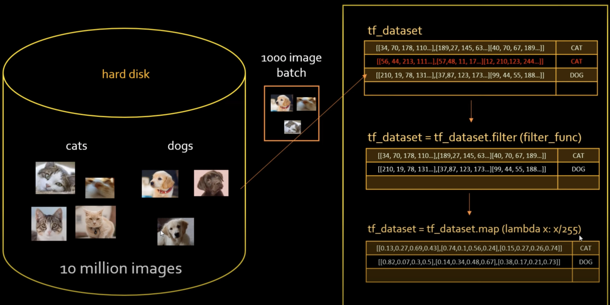
Loading data with tf_dataset batch_size= 10

Slide 6
2. Data Preprocessing
We multiply one images into 4-5 images but with different shape and look
Notes:
Consider talking about:
Relation to data mining
Relation to optimization
Relation to statistics

Slide 7
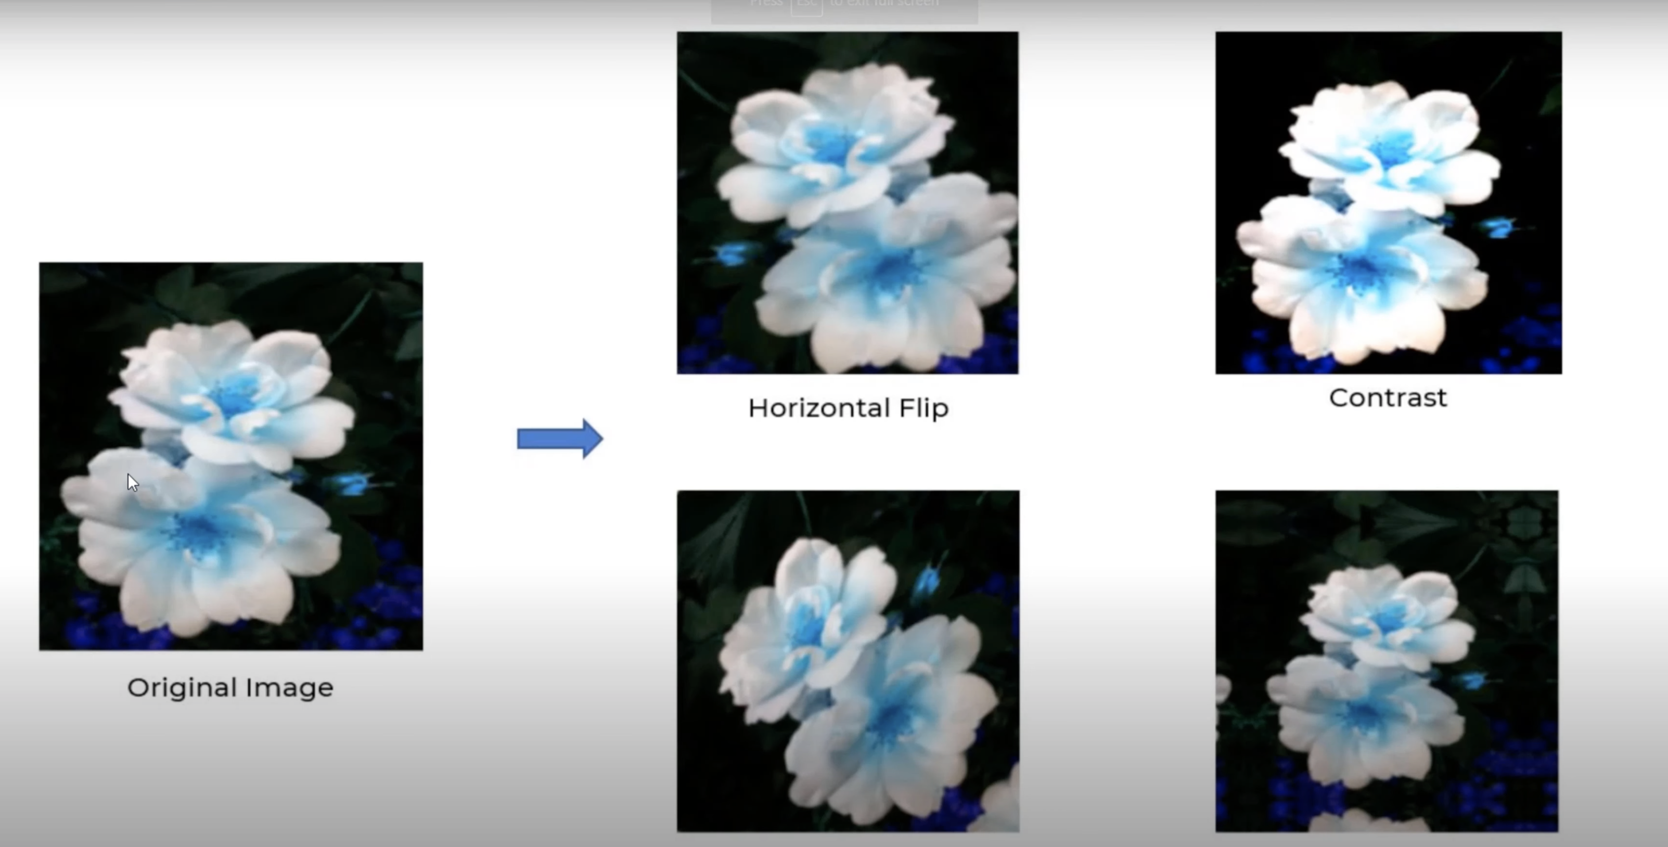
Data augmentation Layer is used to multiply an image
Flip
Random Zoom
Random Rotate
Resize
Rescale
80% of data using for training
10% for validation
10% for testing

Slide 8
3. Training the Model
We are using Convolutional Neural Network (CNN) Algorithm to train a model using training sample
Notes:
Consider talking about:
Relation to data mining
Relation to optimization
Relation to statistics

Slide 9
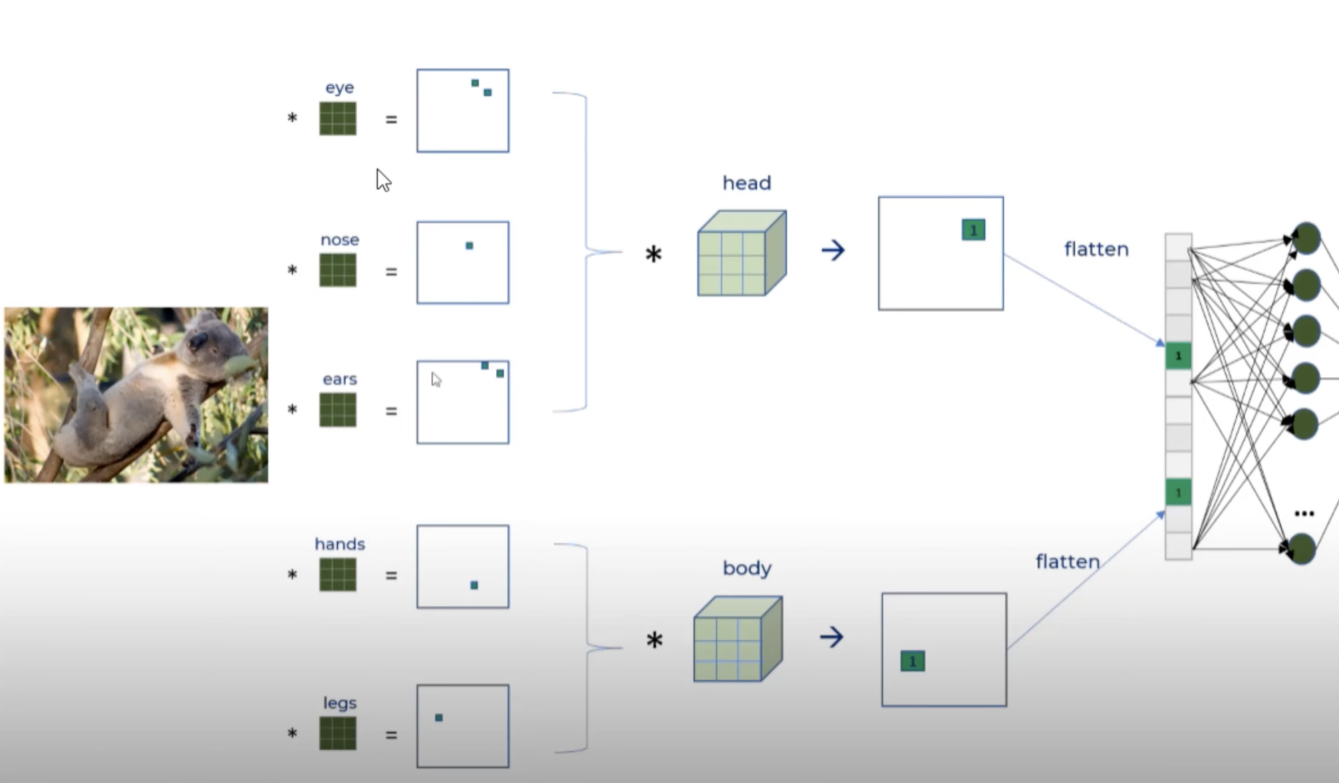
Convolutional Neural Network Algorithm

Slide 10
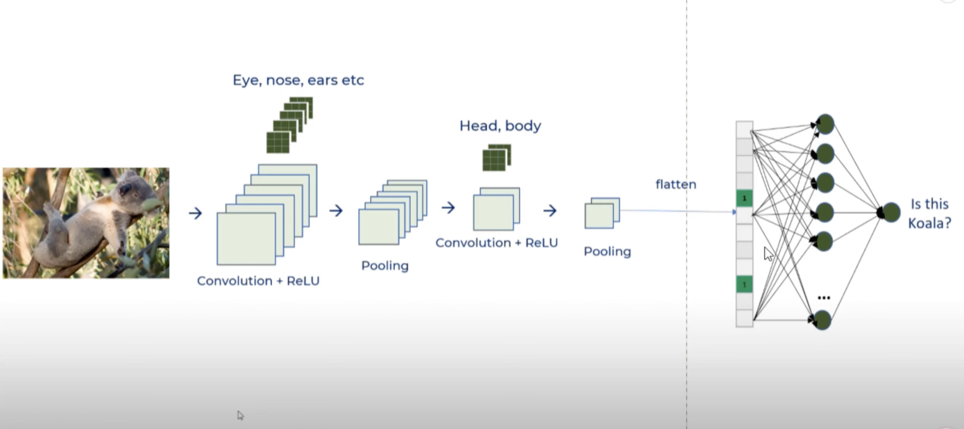
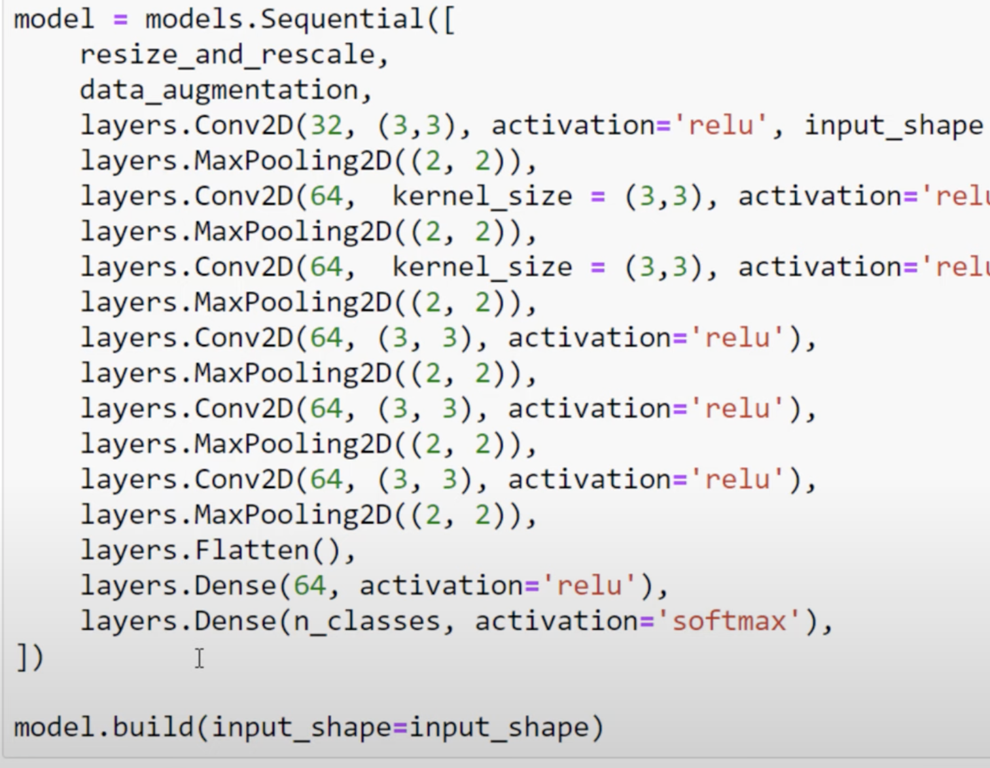
Convolutional Neural Network Layers

Slide 11
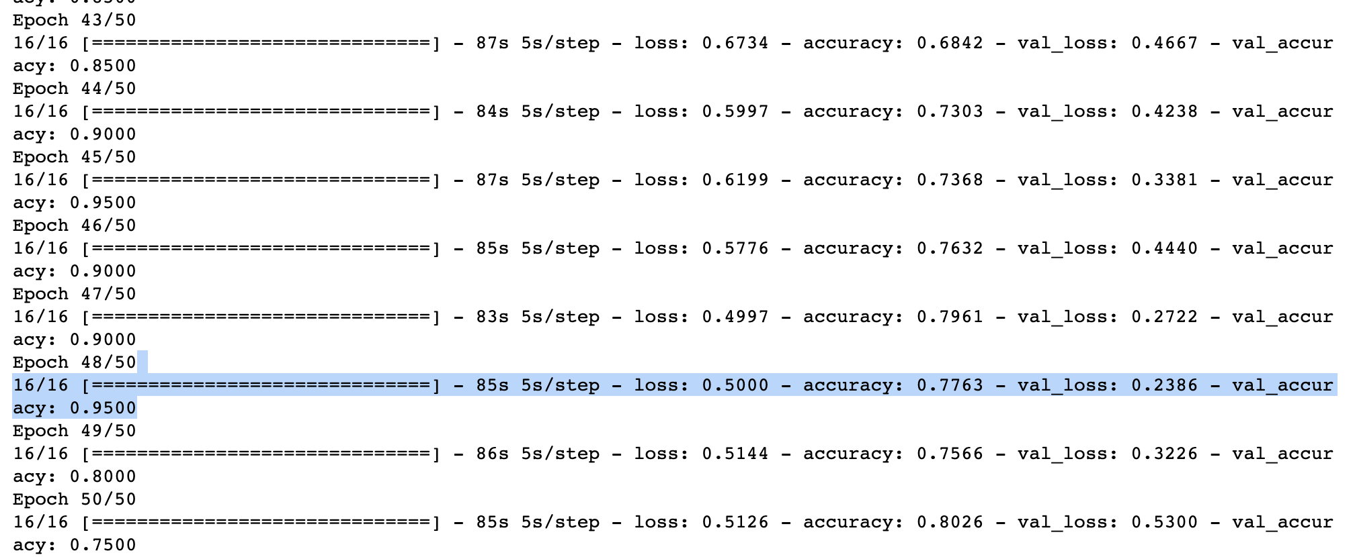
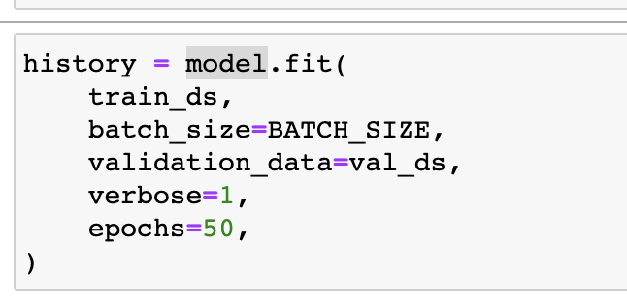
Training The Model 50 rounds and validation

Slide 12
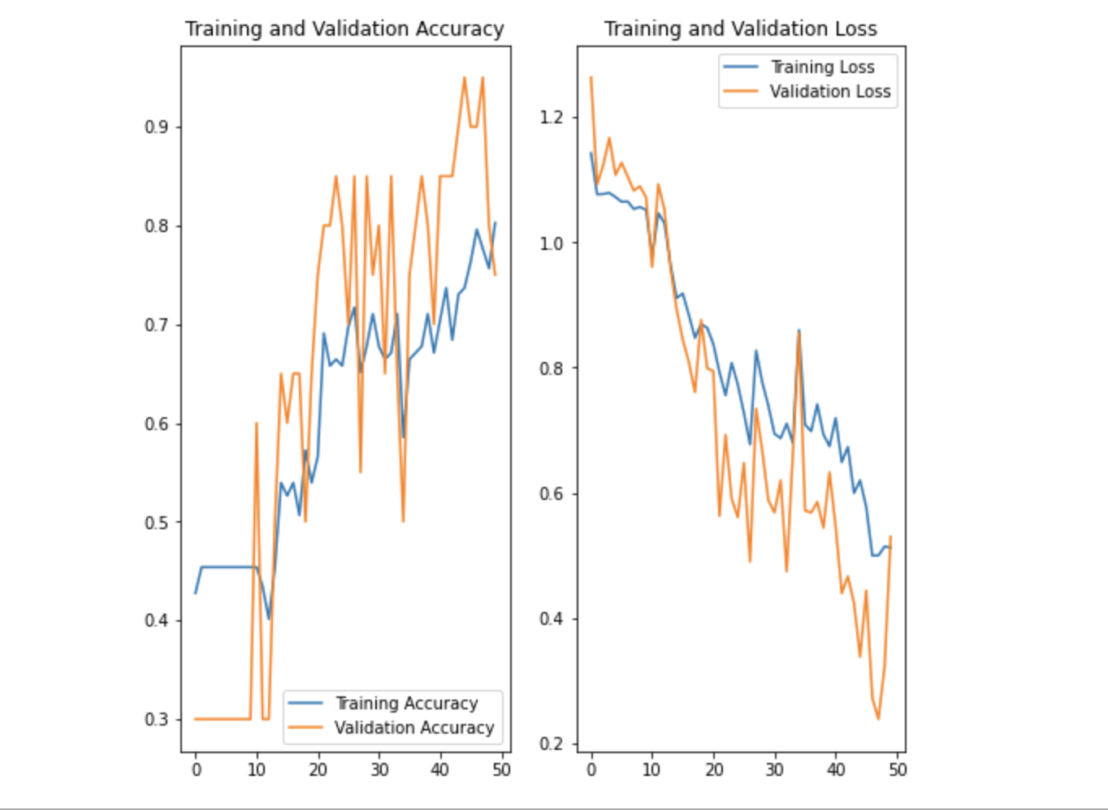
Accuracy Increase steadily toward 90%

Slide 13
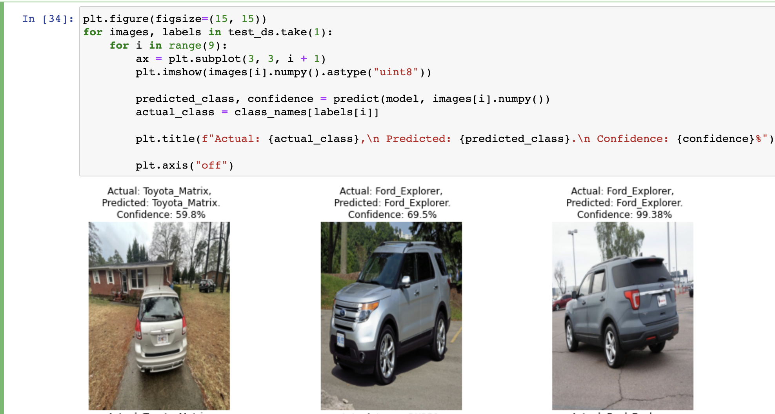
Predicate with Test Sample

Slide 14
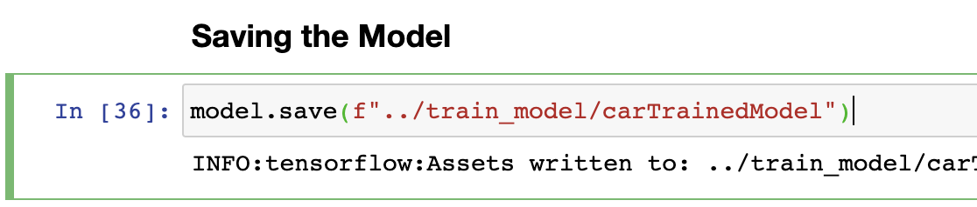
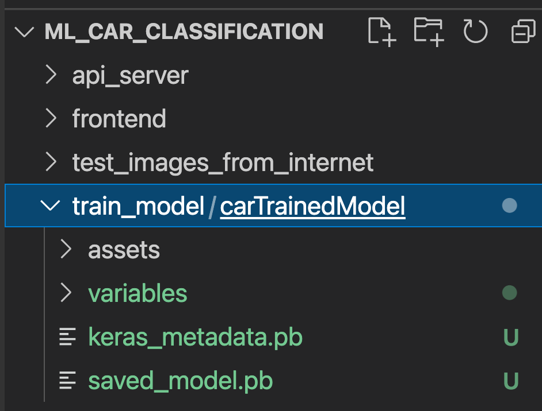
Saving Trained Model

Slide 15
API Server
We are using Python FastAPI Server to Serve the post-api with tenserflow (tf)
Notes:
Consider talking about:
Relation to data mining
Relation to optimization
Relation to statistics

Slide 16
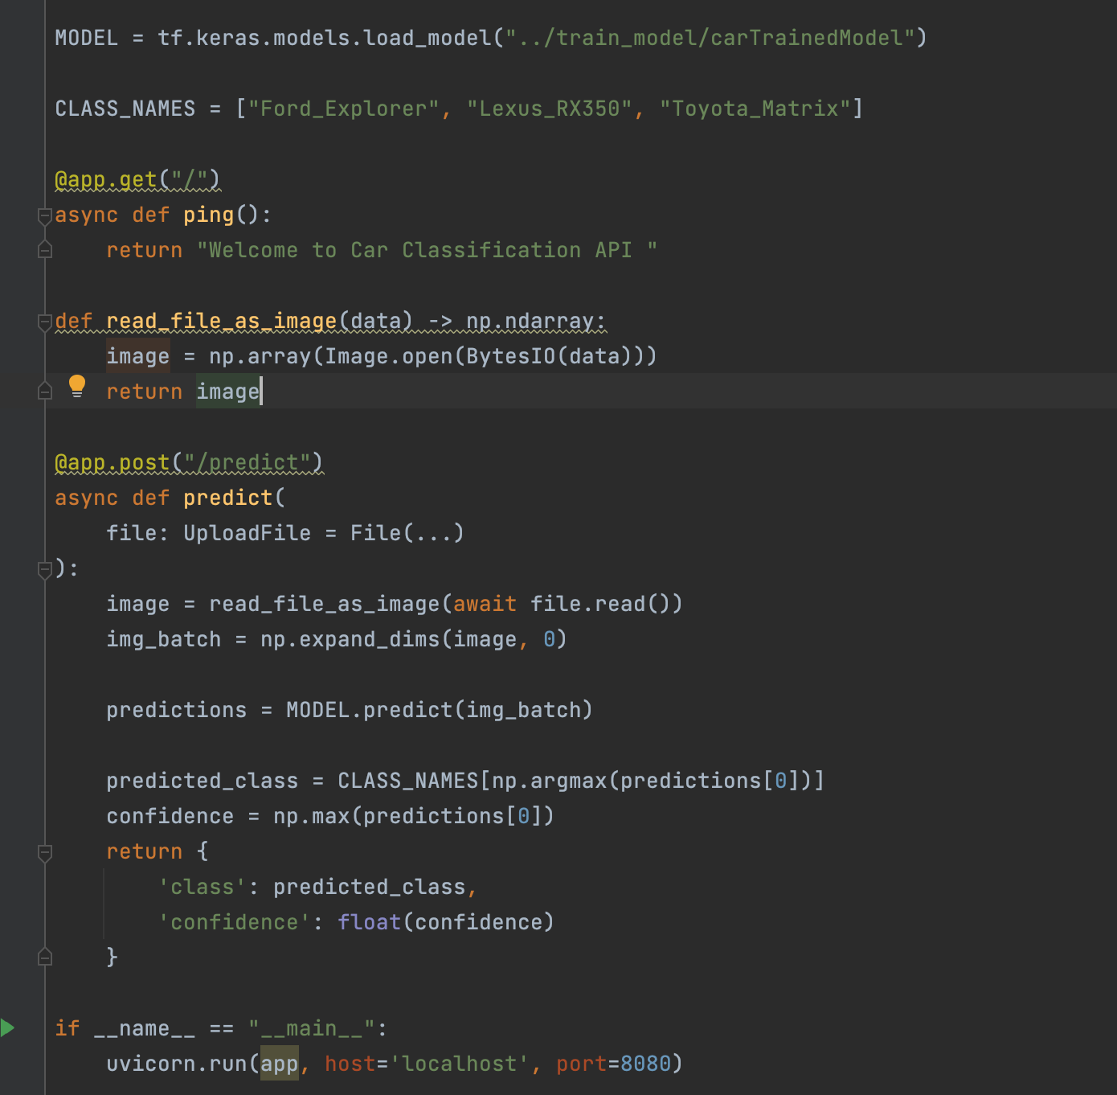
Serving Trained Model with API Server
Notes:
Consider talking about:
Relation to data mining
Relation to optimization
Relation to statistics

Slide 17
4. Consuming API
We use React Javascript Simple App, as simple application to verify the result.
Notes:
Consider talking about:
Relation to data mining
Relation to optimization
Relation to statistics

Slide 18
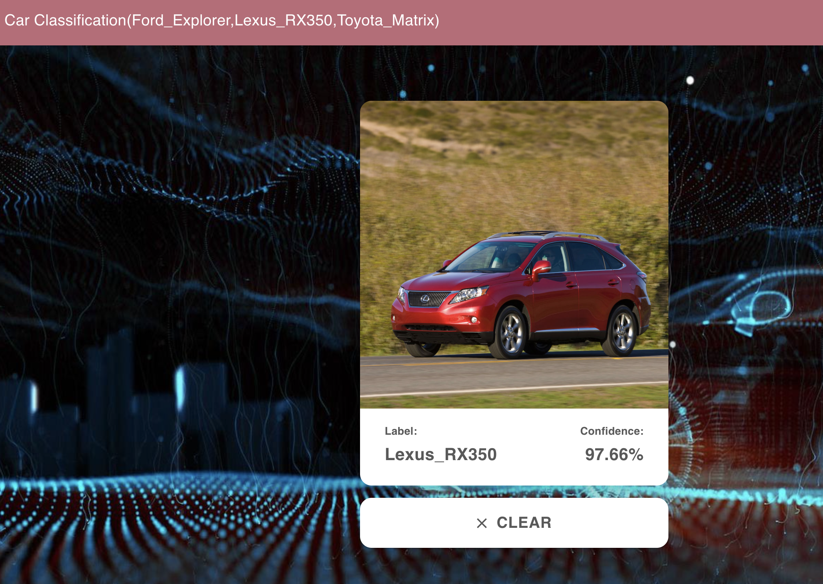
Serving Application with React JS

Slide 19
Thank You

